Slide 1
Deep content-based music recommendation
Aaron van den Oord, Sander Dieleman, Benjamin Schrauwen

Slide 2
Outline
Data Set
Weighted matrix factorization
Predicting latent factors
Bag-of-words representation
Convolutional neural networks
Experiments
Quantitative evaluation
Quantitative evaluation

Slide 3
Data Sets
Million Song Dataset (MSD)
metadata and precomputed audio features
Two linked datasets
Echo Nest Taste Profile dataset
380,000 songs gathered from 1 million users.
Last.fm dataset
tags for over 500,000 songs

Slide 4
Weighted matrix factorization
Use implicit feedback
count play per song and per user
User has never listened to a song
not be aware of it
not to enjoy it
Not compatible traditional matrix factorization algorithms
Approach: Weighted matrix factorization (WMF)

Slide 5
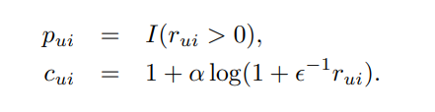
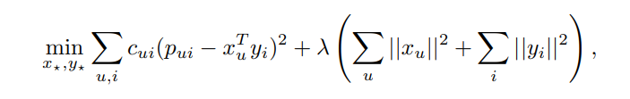
Weighted matrix factorization

Slide 6
Predicting latent factors
Predicting latent factors from the corresponding audio signal is a regression problem
Evaluate two methods:
Bag-of-words representation
Convolutional neural networks

Slide 7
Bag-of-words representation
Extract MFCCs from the audio signals
Aggregate them into a bag-of-words representation
reduced the size PCA

Slide 8
Convolutional neural networks
state of the art in speech recognition and large-scale image classification
Parallellization is used to speed up training
Large amount of training data is required
Million Song Dataset (MSD)

Slide 9
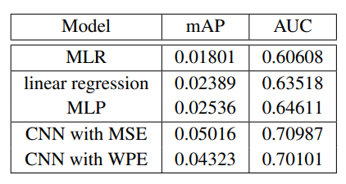
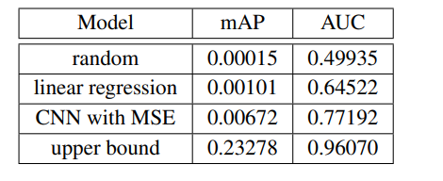
Experiments - Quantitative evaluation
9,330 most popular songs, and listening data for only 20,000 users
full dataset

Slide 10
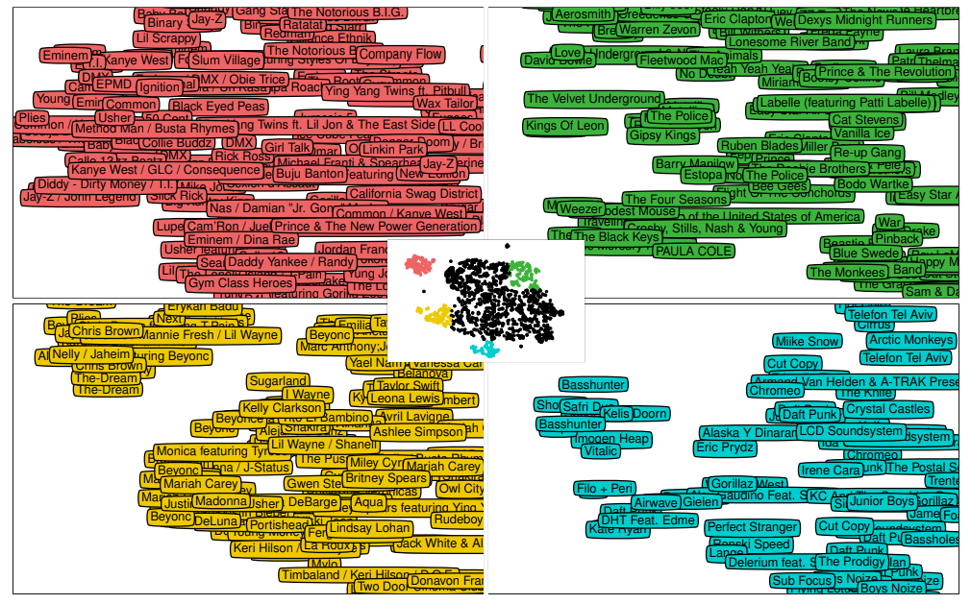
Experiments - Qualitative evaluation
each song, similar songs by measuring the cosine similarity between the predicted usage patterns
latent factors obtained with WMF (50 dimensions)
matched songs are likely to appeal to the same audience
useful property for recommender systems

Slide 11
Thank you for your attention!

